Slide 1
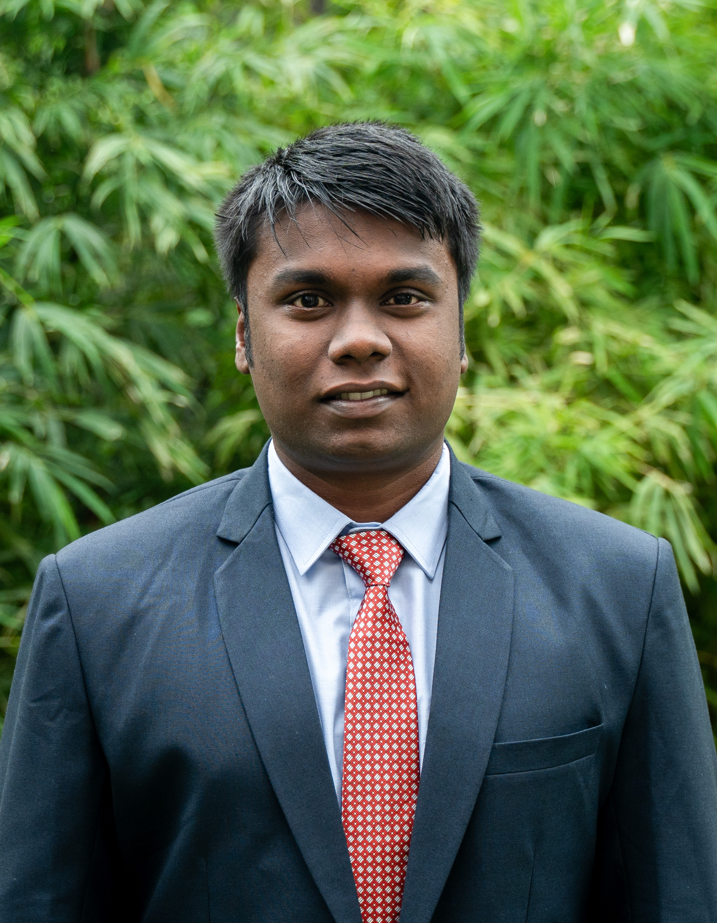


FUTURE OF EDUCATION REIMAGINING THE WAY WE LEARN
LYNCUS
Connect. Collaborate.
Create.
DIGITAL CAMPUS ECOSYSTEM
Akanksha: A Business Plan
National Institute of Agricultural Extension Management (MANAGE)
T P KAARMUGILAN
SAGAR METRI
T C ABHIRAM

Slide 2
















LYNCUS
Market Opportunity & Business Model
Connect. Collaborate. Create.
Research & Insights
HEIs in India
HEI’s Students
EdTech CAGR
MBA Students
Insights Derived from Primary Research
Problem
75%
Demand
82%
Networking
78%
78% - use multiple platforms for college communication
64% - have missed important academic/campus updates
82% - prefer a centralized campus platform
59% - are interested in cross-college networking
64,756+
4.5 Cr+
16.9%
2.85 Lakh
The problem
Market Gap
TAM
64K+ institutions, 4.5 Cr students.
₹1,001 Cr
Fragmented Information - WhatsApp, emails, ERP/LMS & notices.
Missed Opportunities - Classes, assignments, events & internships.
Poor Coordination - Disconnected communication between stakeholders.
Multiple Platforms - No single place for campus needs.
No Student-First Platform - ERPs focus mainly on administration.
Disconnected Services - Academics, careers & events are separate.
Ltd Cross-College Network - Few platforms connect students across campuses.
No Affordable All-in-One Sol. - Complete campus ecosystem is missing.
SAM
₹89 Cr
S0M
15K+ pvt. institutions, ~12M students,
₹13 Cr
LYNCUS - Unit Economics
Metric | Per Student / Year
Admin SaaS Revenue | ₹20
Student Premium Revenue | ₹82.50
Ad Revenue | ₹120
Total Revenue / Student | ₹222.50
Basic Model - Free
Core campus features free for students, faculty & colleges.
Builds a large user base and drives adoption.
1.5k Colleges - 600k Students = 13.3cr
15% Student Premium Conversion
20% Paying Colleges
Admin Premium
Paid tools: Exams, Tests, Assignments, Advanced Attendance, Plagiarism & Analytics.
Colleges pay based on premium usage/student access.
Student Premium
AI Mentor, Personalized CV, Career Guidance & Personal Analytics.
Subscription-based premium services for students.
Target customer
Primary
BUSINESS MODEL
Users
College Advertising
Colleges pay to promote events, fests, competitions & announcements.
Targeted promotion to relevant student communities.
Initial Market-Management Universities & Business Schools, Postgraduate Colleges
Students
Faculty / Lecturers
College Administrators
Clubs & Committees
Recruiters
Future Expansion
Commercial Advertising
Companies/recruiters pay for ads, internships, jobs & student opportunities.
Revenue grows with LYNCUS's student network.
UG Colleges & Universities
Engineering, Agriculture & other professional institutions, School Chains ( Coaching institutes)
Global Expansion
Future Partnerships
Recruitment, campus hiring, competitions & strategic partnerships.
Additional revenue as the platform scales.

Slide 3


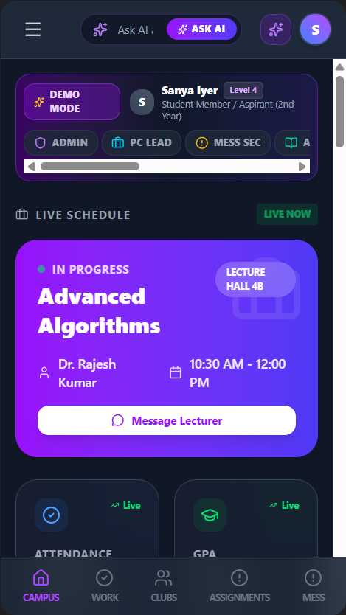
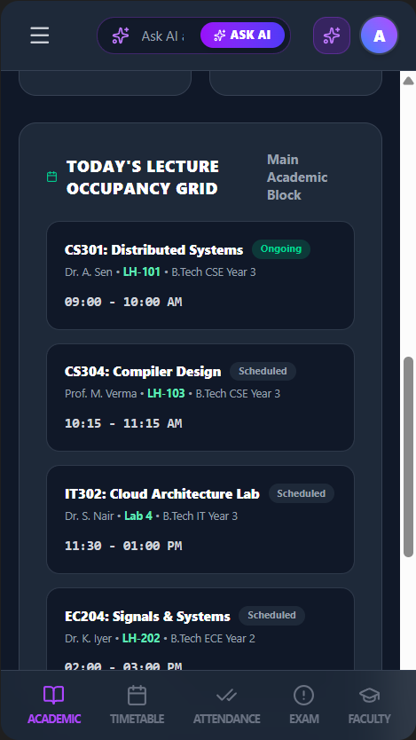
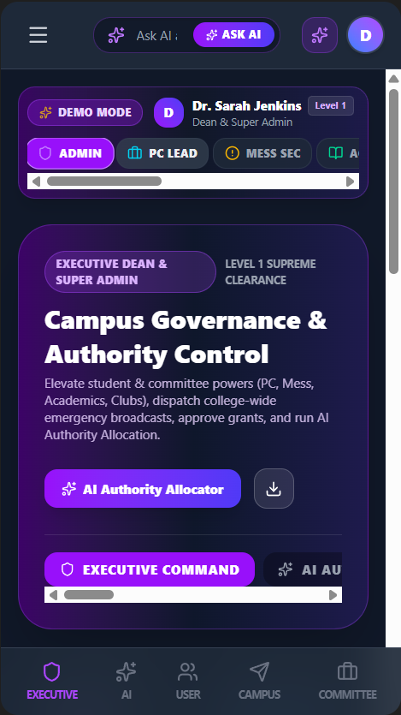
LYNCUS
GTM, Product & Growth Roadmap
Connect. Collaborate. Create.
1
PILOT
2
IMPROVE
3
EXPAND
4
SCALE
0-3 Months / 10-20 Colleges
3-6 Months / 100-150 Colleges
6-18 Months / 500-2,000 Colleges
18+ Months / 10,000+ Colleges
Directly pitch and onboard pilot colleges.
Launch MVP and test core features.
Collect student/admin feedback and validate demand.
Leverage testimonials, referrals & pilot success.
Improve UI/features based on feedback.
Standardize onboarding and establish IP/legal protection.
Scale through campus ambassadors & referrals.
Introduce standardized onboarding and operations.
Launch cross-college networking and opportunities
Expand from PG/MBA → UG colleges.
Build a nationwide student network.
Integrate recruitment, career opportunities & partnerships.
GO TO MARKET STRATEGY
VALUE PROPOSITION
User Interface
One-Stop Campus Hub
Smarter Campus management
Everything in one app
Classes, assignments, updates & events
Less dependence on multiple platforms
Simple & affordable
Streamlined admin & faculty coordination
Clubs and committees in one system
Students
Club & Committee
Admin
Personalized Career Growth
LYNCUS
Cross-College Network
AI-powered career support
CV, GD/PI & career guidance
Jobs, internships & opportunities
Connect beyond your campus
Discover competitions & events
Student, club & committee networking
 | Year 1 | Year 2 | Year 3 | Year 4
S&M spend | ₹4.2L | ₹9.2L | ₹34.5L | ₹110.4L
New colleges | 20 | 60 | 320 | 1,100
CAC/ college | ₹21,000 | ₹15,333 | ₹10,781 | ₹10,036
New students | 8,000 | 24,000 | 1,28,000 | 4,40,000
CAC/ Student | ₹52.5 | ₹38.3 | ₹27.0 | ₹25.1

Slide 4
























LYNCUS
Competitive Advantage & Cost Strategy
Connect. Collaborate. Create.
COMPETITORS ANALYSIS
COMPETITIVE ADVANTAGE
Competitor | Area of competition
 | They provide ERP, LMS, exams, attendance, clubs and campus engagement through one platform.
 | They help colleges manage academics, campus activities, engagement and analytics digitally.
 | They provide attendance, timetables, exams, assignments, fees and communication for institutions.
Unified Digital Ecosystem
Connected Campus Network
Academics, campus services, clubs & communication in one platform.
Eliminates multiple apps and WhatsApp groups.
Connects students beyond their own campus.
Enables access to inter-college events, competitions, internships & jobs.
CollPoll
Student-First Experience
Role-Based Management
Built around students’ daily needs, routines and opportunities.
Simpler and more intuitive than traditional ERP/LMS systems.
Clubs and committees manage their sections independently.
Enables real-time updates with less admin involvement.
Digiicampus
Integrates, Not Replaces
Scalable SaaS Platform
Works alongside existing ERP and LMS systems.
Easy implementation with minimal switching costs.
Institutions adopt only the features they need.
Easily scales across students, colleges and new features.
Campus.uno
REVENUE STREAMS
4-Year Financial Outlook
ADMIN
STUDENTS
- REVENUE
Key Metric | Year 1 | Year 2 | Year 3 | Year 4
Onboarded Colleges | 20 | 80 | 400 | 1,500
Active Students | 8,000 | 32,000 | 1,60,000 | 6,00,000
Projected Revenue | ₹17.8 L | ₹71.2 L | ₹3.56 Cr | ₹13.35 Cr
Total Cost | ₹42 L | ₹92 L | ₹2.30 Cr | ₹9.20 Cr
Net Profit / (Loss) | (₹24.2 L) | (₹20.8 L) | +₹1.26 Cr | +₹4.15 Cr
Net Margin | -136% | -29% | 35% | 31%
Cumulative Cash Position | (₹24.2 L) | (₹45.0 L) | +₹81 L | +₹4.96 Cr
Smart Tests
Create and auto-grade quizzes and tests.
AI Personal Mentor
1:1 AI mentor for academics and career
College Ads
Other college ads about admissions & events
Adv. Attendance
QR/Geo based tracking with automated reports
CV Builder
Auto-generated, ATS ready CV from profile
Common Ads
Normal ads about edu and other food platform
x
Plagiarism check
Scan submitted reports for originality
Career Guidance
Curated career paths & personalized roadmap
Competitions
Case competitions and sports events
Analytics
Class & department engagement dashboards
Personal Dashboard
Track grades attendance and growth
Passive revenue that scales with every free user on the platform.

Slide 5



LYNCUS
Connect. Collaborate. Create.
THANK YOU
“We’re not just connecting colleges. We’re connecting possibilities.”

Slide 6
Appendix
LYNCUS
Connect. Collaborate. Create.
Market & Industry Sources
MarketsandMarkets - India EdTech & Smart Classrooms
Use this for your 16.4% EdTech CAGR / $8.88B → $19.00B claim. – link
Grand View Research — India Higher Education Technology
Use this for the higher-education technology market claim. – link
Use this for the overall higher education market claim.– link
AISHE / Ministry of Education - Higher Education Statistics – link
LYNCUS
Google form Responses
Website link
TAM, SAM & SOM CALCULATION
Revenue per Active Student
Admin SaaS = ₹20/student/year
Student Premium = ₹82.50/student/year
Advertising = ₹120/student/year
Total LYNCUS Revenue = ₹222.50/student/year
TAM - Total Addressable Market
4.50 Cr Higher Education Students
× ₹222.50/student/year
= ₹1,001.25 Cr
TAM ≈ ₹1,001 Cr
64,756+ HEIs | 4.50 Cr students
6 lakh students
SAM - Serviceable Available Market
10,000 Target Colleges
× 400 students/college
× ₹222.50/student/year
= ₹89 Cr
SAM = ₹89 Cr
~40 lakh students
SOM - Serviceable Obtainable Market
1,500 Target Colleges
× 400 students/college
× ₹222.50/student/year
= ₹13.35 Cr
SOM = ₹13.35 Cr

